Slide 1
Learn how to log on to public services with BankID on mobile
Notes:
This course is made for those who wants to learn how to log on to public services with BankID on mobile.
If you want the course to be a practical course in how to log on with BankID on mobile, the participants must have obtained a BankID before the course starts.
«Manuscipt»: The teacher should use this information to more clearly present the information in the slides.
«Additional information for the teacher»: This is only background information for the teacher to have some more knowledge about BankID on mobile, or if the participants have questions.

Slide 2
What does it mean to log in with an electronic ID?
to identify oneself electronically
to access information about yourself
Example of digitale public services:
your tax return
e-prescription on Helsenorge
your pension from NAV
Notes:
«Manuscipt»:
To log in is a way to access public services.
When you are logged in, you can access information that the public has registered about you. Example: When your car needs mandatory roadworthiness test (EU-kontoll), information about your property or information about your tax deduction card.
When you are logged in you can submit forms, and public agencies are then sure that it is you who submits. Example: application for change of name, apply for pension or change of address.

Slide 3
How to identify yourself online?
In person you identify yourself with a passport, driver’s license or national ID-card.
Online you identify yourself with a personal electronic ID, such as BankID on mobile.
Notes:
Manuscript:
It is not enough to write who you are with words online, to access information related to you.
You must prove with a personal electronic ID that you are who you claim to be.
Additional information for the teacher:
It is the citizens themselves who must obtain electronic identification (e-ID) to use online.
You can select between six electronic ID`s to log on to online public services.

Slide 4
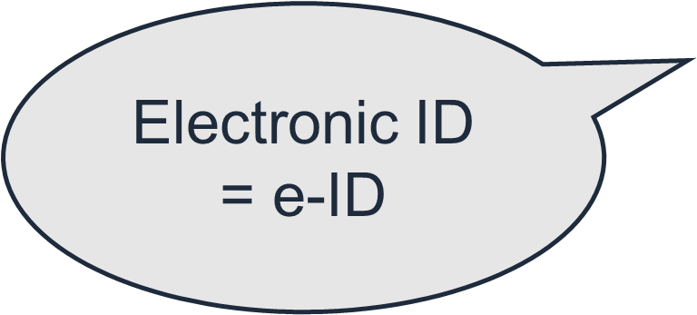
What is BankID on mobile
BankID is a personal electronic identification (electronic ID)
Notes:
Manuscript:
Electronic identification has several names, but means the same thing: electronic identification online, electronic identity, electronic ID, e-ID or eID.
To log on to a public service, you must log on using a code from a code generator: code unit, code card or code app (some banks) issued to you personally.
Additional information for the teacher:
BankID is delivered and operated by the banks.
The bank decides who can get a BankID.
You have to identify yourself at the bank to get a BankID.
The bank decides if a citizen with a D-number can get a BankID.
BankID is one of several electronic IDs to choose from.
BankID provides access to public services at the highest level of security.
You can use BankID on PC, tablet and mobile phone.

Slide 5
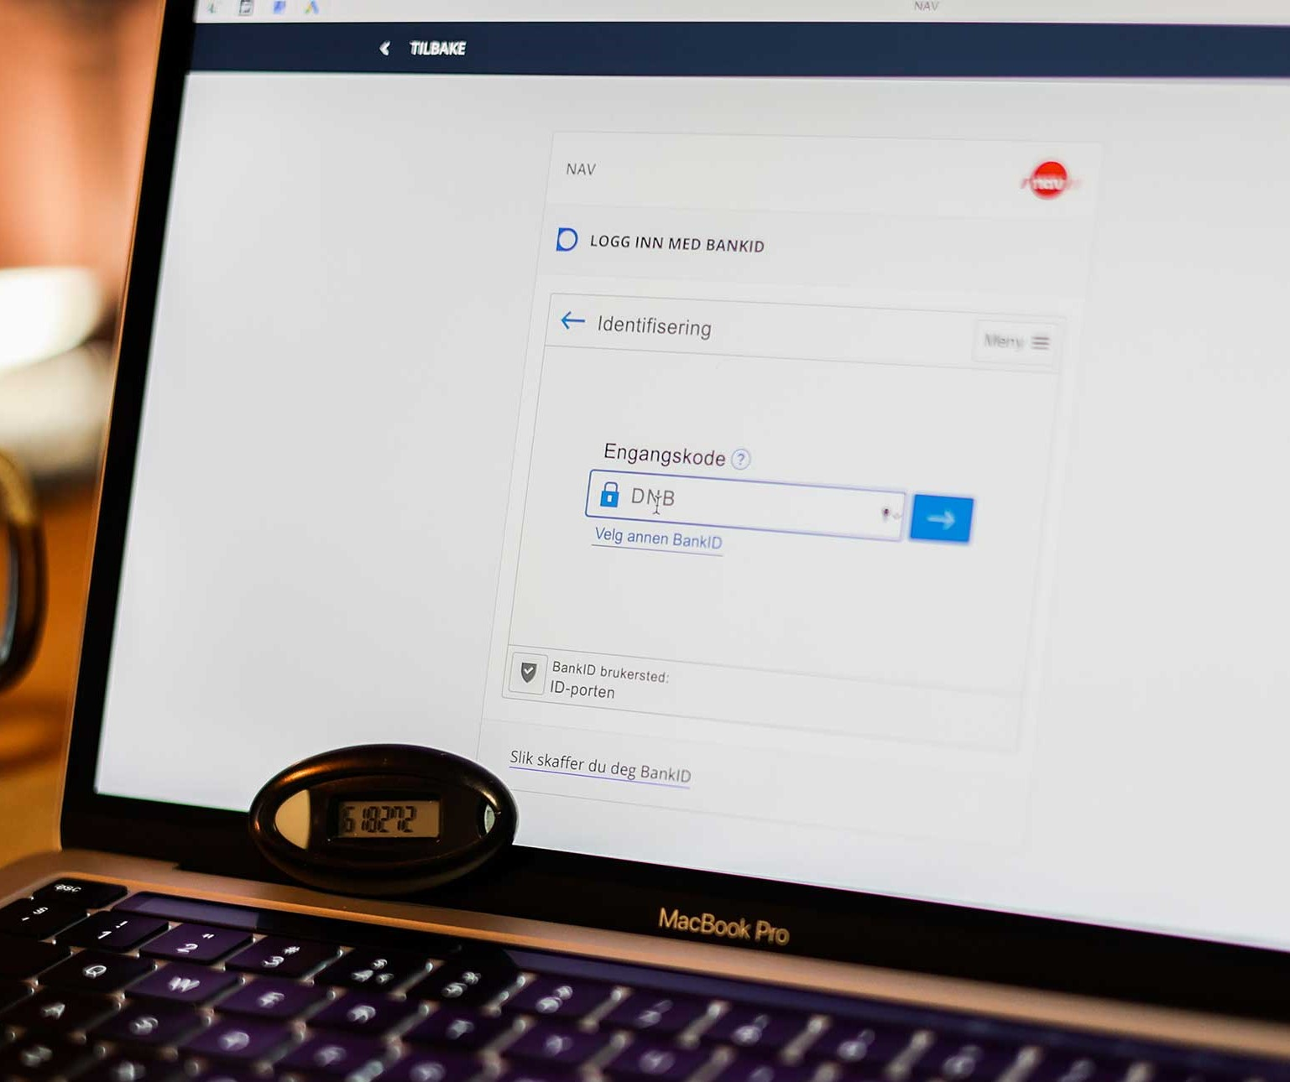
How to get BankID on mobile?
Contact your BankID and ask for BankID
The Bank will send you a code generator
Log in to your online bank with BankID and activate your BankID on mobile
Notes:
Manuscript:
If you have already obtained a BankID, you can activate BankID on mobile in your online bank.
If you want to order BankID on mobile, ask for BankID with a code unit (someone has a code card or an app) at your bank first. Log on to your online bank and activate your BankID on mobile in the menu.
The bank can guide you on how to log on to your online bank, and how to activate your BankID on mobile.
Additional information for the teacher:
You must be a customer of a bank to get a BankID on mobile. You must also identify yourself with your passport at the bank.
The bank will send you a code generator that is connected only to you and your personal ID number.

Slide 6
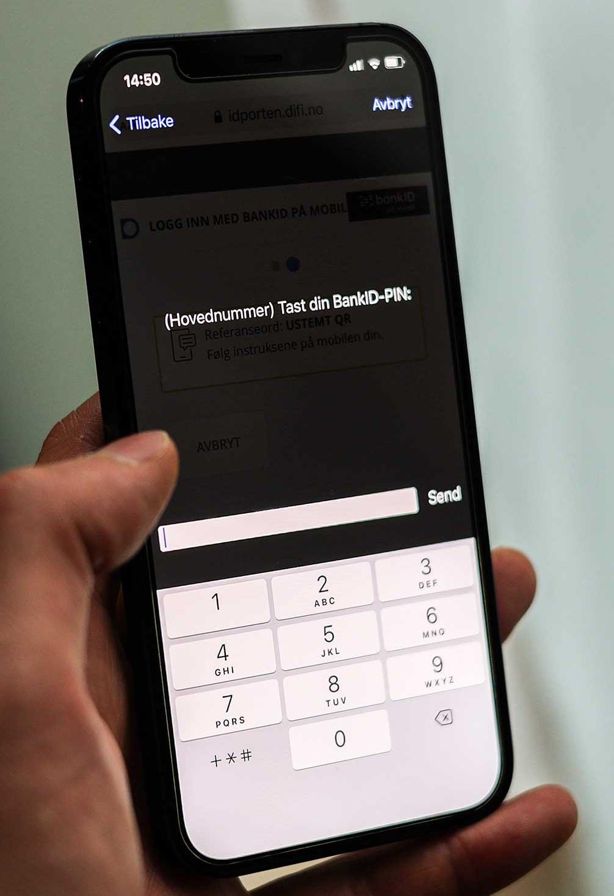
To use BankID på mobil you need:
A mobile phone
Your PIN code for BankID on mobil
Notes:
Manuscript:
To use BankID on mobil, you must have a mobile phone which support this service from the bank. You can check this from your online bank.
You have to create a PIN code that you must use when logging in with BankID on mobile. You create the code when you activate your BankID on mobile in your online bank
Additional information for the teacher:
You must always use your own code generator to log on and activate your BankID on mobile.

Slide 7
Notes:
Manuscript:
To log on to a public website: enter the web address (URL) of the public agency in the address bar in your browser.
On some public websites you have to find the service before you can log on.
In this example we are using NAV. Note that you can choose english at the bottom of the page.
Additional information for the teacher:
You can also use a search engine to find a public website/public service or find a service at www.norge.no.

Slide 8
Notes:
Manuscript:
ID-porten is a secure entrance to services from central and local government.
If you want to log on to public services with an electronic ID, you must log on with ID-porten.
ID-porten offers several different types of electronic ID’s.
Additional information for the teacher:
You can have more than one electronic ID. Choose BankID on mobile in this example.
There are two different security levels. MinID has a substantial level of security (level 3), and the others are at the highest level of security (level 4).

Slide 9
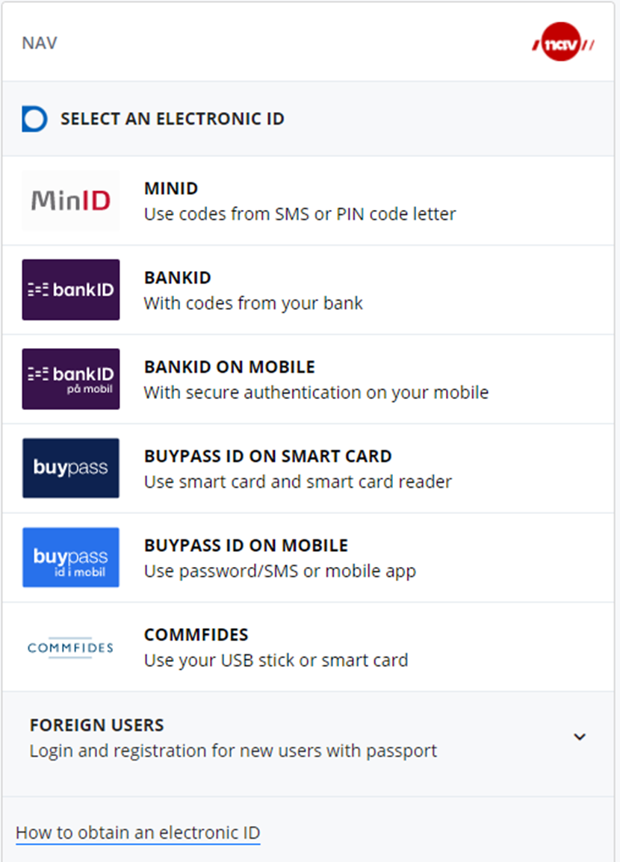
Select BankID på mobil to log on
Click on BankID on mobile
Notes:
Manuscript:
Click on BankID on mobile in ID-porten.
BankID on mobile gives you access to all public services.
Additional information for the teacher:
Some services requires an electronic ID at the highest level of security. BankID on mobile has the highest level of security.

Slide 10
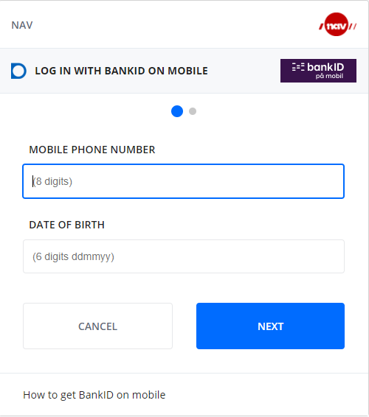
Enter your mobile number and date of birth
Enter your mobile phone number
Enter your date of birth
Click on «Next»
Notes:
Manuscript:
Enter your mobile phone number, no space.
Enter your date of birth, 6 digits and no space.
Click on «Next» or the enter button on your keyboard.
Additional information for the teacher:
If you have a D-number, you can usually not use BankID on mobile.

Slide 11
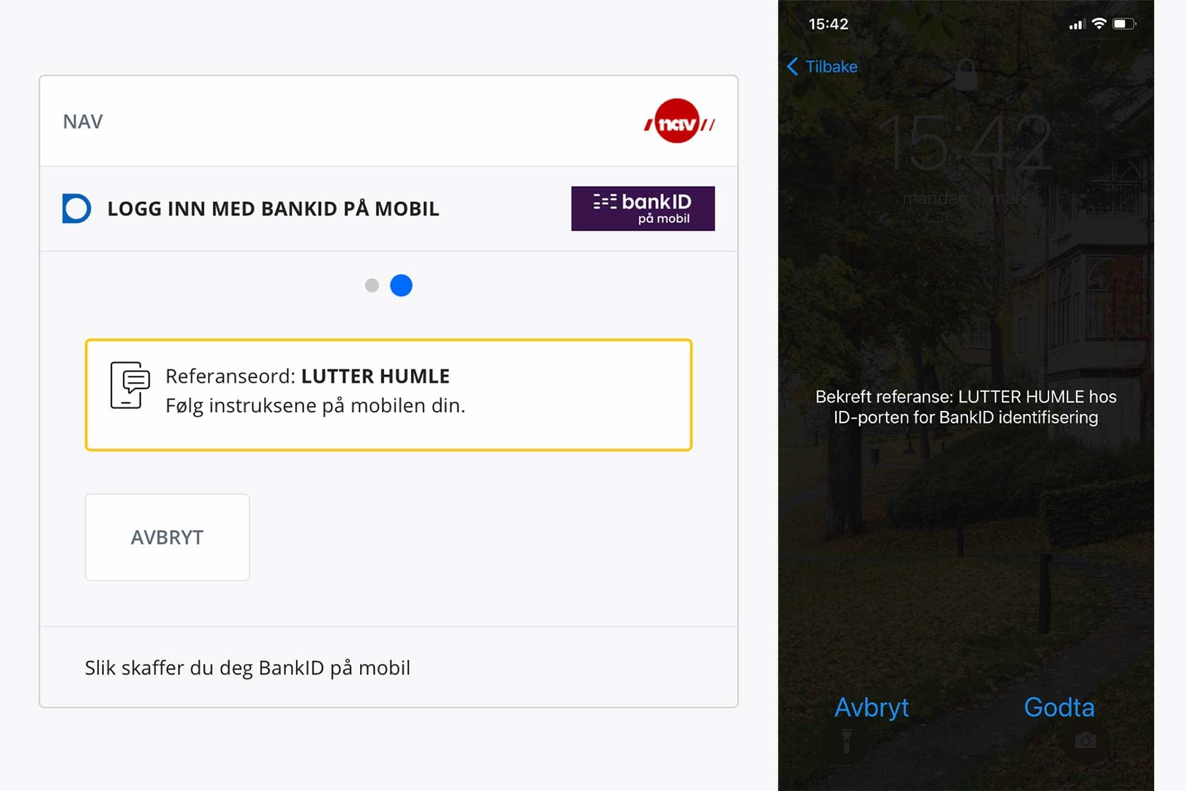
Make sure the reference word is the same
Click on «godta» on your mobile phone
Notes:
Manuscript:
A reference word will appear on the screen. Make sure the reference word on your mobile phone is the same as the reference word on the screen, click “Godta" on your phone.
Additional information for the teacher:
Contact your bank if you have problems logging in with BankID on mobile.
You can log on from a computer, tablet or from your mobile phone, the procedure is the same

Slide 12
Enter your personal PIN code
«Tast ID-PIN», enter your PIN code
Click on «Send»
Notes:
Manuscript:
Enter your personal PIN code on your phone to complete the login. The PIN code is the one you created for BankID on mobile in your online bank.
Click on «Send» on your mobile phone.
Additional information for the teacher:
If you enter the PIN code wrong too many times, your BankID on mobile will be blocked. Please contact your bank to reopen your BankID on mobile.

Slide 13
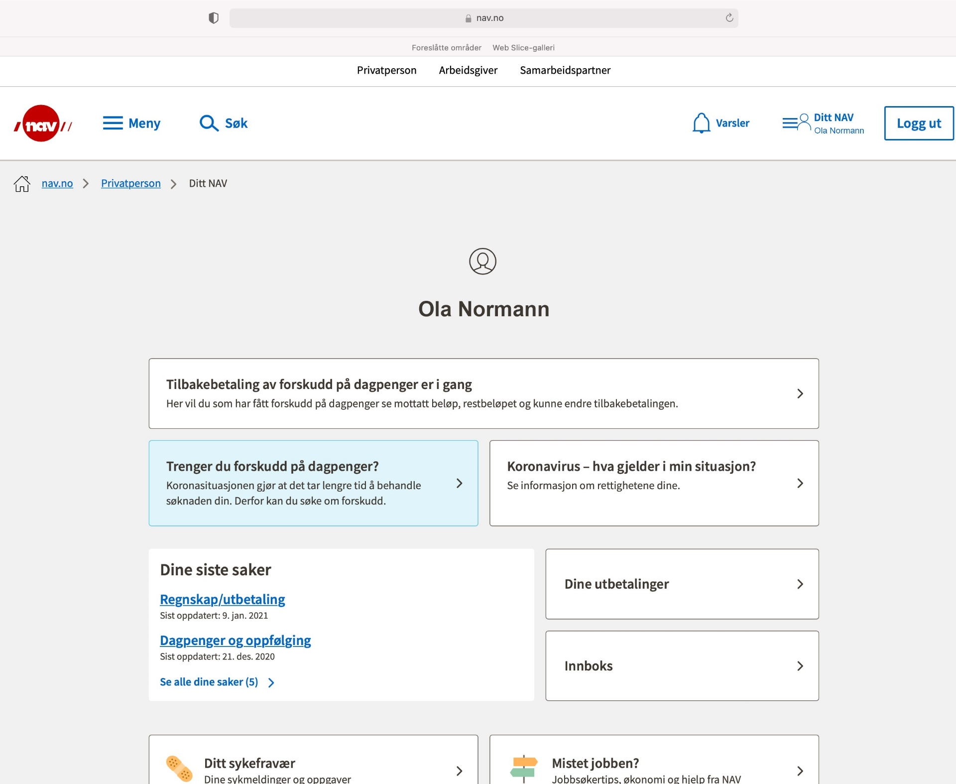
You have now logged on to NAV
Your personal services at NAV
Notes:
Manuscript:
You have now logged on to NAV's services. Your name will appear on the screen.
You can find information about yourself, change information or submit forms once you have logged on.
Make sure to log out when you are done.

Slide 14
Notes:
Manuscript:
At Norge.no we have gathered digital services from central and local government you can log on to.
You can look for a specific service, you can find a service based on the life situation you are in, and you can search for services on Norge.no
Additional information for the teacher:
At Norge.no you can log on and change your contact information that central and local government can reach you at.
You will also find information about digital mailbox.
A separate course has been created on how to find services from www.norge.no. There are also separate courses in how to log on with your electronic ID MinID and BankID on mobile.

Slide 15
Notes:
Manuscript:
If you need help logging in, go to the bottom of the page. There is a link to our help pages, you can send us an email or a chat. You can call our help desk at tel. 800 30 300.
Additional information for the teacher:
Our website address: www.idporten.no .
On our website you can find help and information about all our electronic ID’s.

