Slide 1
Learn how to log on to public services with BankID
Notes:
This course is made for those who wants to learn how to log on to public services with BankID.
If you want the course to be a practical course in how to log on with BankID, the participants must have obtained a BankID before the course starts.
«Manuscipt»: The teacher should use this information to more clearly present the information in the slides.
«Additional information for the teacher»: This is only background information for the teacher to have some more knowledge about BankID, or if the participants have questions.

Slide 2
What does it mean to log in with an electronic ID?
to identify oneself electronically
to access information about yourself
Example of digitale public services:
your tax return
e-prescription on Helsenorge
your pension from NAV
Notes:
«Manuscipt»:
To log in is a way to access public services.
When you are logged in, you can access information that the public has registered about you. Example: When your car needs mandatory roadworthiness test (EU-kontoll), information about your property or information about your tax deduction card.
When you are logged in you can submit forms, and public agencies are then sure that it is you who submits. Example: application for change of name, apply for pension or change of address.

Slide 3
How to identify yourself online?
In person you identify yourself with a passport, driver’s license or national ID-card.
Online you identify yourself with a personal electronic ID, such as BankID.
Notes:
Manuscript:
It is not enough to write who you are with words online, to access information related to you.
You must prove with a personal electronic ID that you are who you claim to be.
Additional information for the teacher:
It is the citizens themselves who must obtain electronic identification (e-ID) to use online.
You can select between six electronic ID`s to log on to online public services.

Slide 4
What is BankID?
BankID is a personal electronic identification (electronic ID)
Electronic ID
= e-ID
Notes:
Manuscript:
Electronic identification has several names, but means the same thing: electronic identification online, electronic identity, electronic ID, e-ID or eID.
To log on to a public service, you must log on using a code from a code generator: code unit, code card or code app (some banks) issued to you personally.
Additional information for the teacher:
BankID is delivered and operated by the banks.
The bank decides who can get a BankID.
You have to identify yourself at the bank to get a BankID.
The bank decides if a citizen with a D-number can get a BankID.
BankID is one of several electronic IDs to choose from.
BankID provides access to public services at the highest level of security.
You can use BankID on PC, tablet and mobile phone.

Slide 5
How to get BankID?
Contact your BankID and ask for BankID
The Bank will send you a code generator
Log in to your online bank and activate your BankID in the menu.
Notes:
Manuscript:
When you receive the code generator, log on to your online bank and activate your BankID for public services in the menu.
The bank can guide you on how to log on to your online bank, and how to activate your BankID.
Additional information for the teacher:
You must be a customer of a bank to get a BankID. You must also identify yourself with your passport at the bank.
The bank will send you a code generator that is connected only to you and your personal ID number.

Slide 6
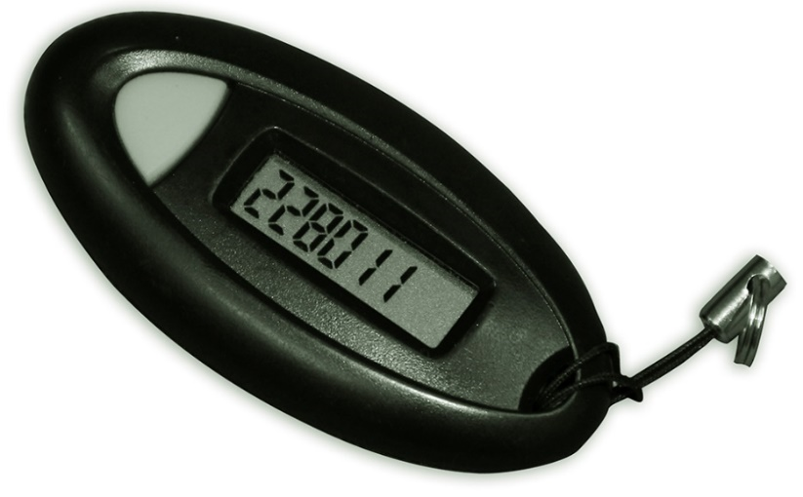
Log on to public services with BankID
+
+
Personal ID number
Personal password
Notes:
Manuscript:
To log on you need your personal ID number (11 digits), code generator and your personal password.
Open the public website you want to log on to.
We recommend that you register both your email address and your mobile phone number in the registration prosess. The information is stored in the common contact register used by central and local government.
Additional information for the teacher:
You must always use YOUR personal code generator to log on.
Note that you must never give another person access to your BankID.

Slide 7
Example: how to log on to NAV
Enter www.nav.no in the address bar in your browser
Click on
«LOG IN»
Notes:
Manuscript:
To log on to a public website: enter the web address (URL) of the public agency in the address bar in your browser.
On some public websites you have to find the service before you can log on.
In this example we are using NAV. Note that you can choose english at the bottom of the page.
Additional information for the teacher:
You can also use a search engine to find a public website/public service, or find a service at www.norge.no.

Slide 8
ID-porten – the entrance to online public services
Log on with ID-porten
Notes:
Manuscript:
ID-porten is a secure entrance to services from central and local government.
If you want to log on to public services with an electronic ID, you must log on with ID-porten.
ID-porten offers several different types of electronic ID’s. Click on “BankID”
Additional information for the teacher:
You can have more than one electronic ID. Choose BankID in this example.
There are two different security levels. MinID has a substantial level of security (level 3), and the others are at the highest level of security (level 4).

Slide 9
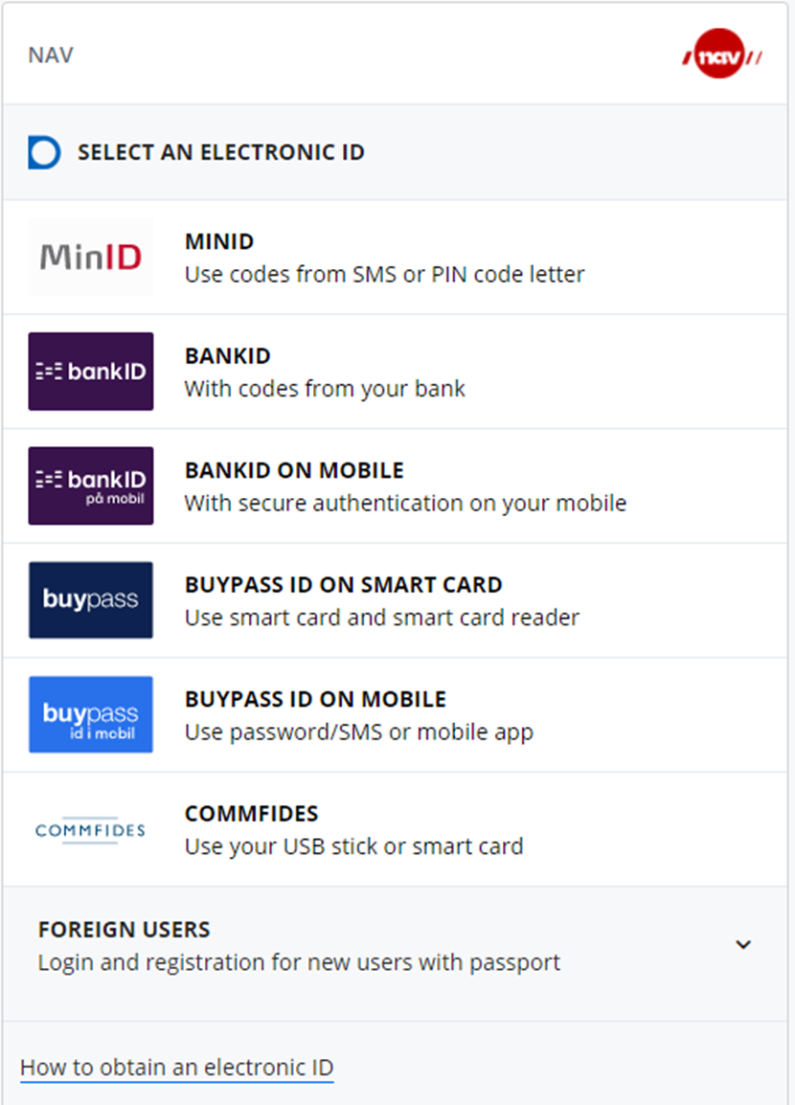
Select BankID to log on
Click on BankID
Notes:
Manuscript:
Click on BankID in ID-porten.
BankID gives you access to all public services.
Additional information for the teacher:
Some services requires an electronic ID at the highest level of security. BankID has the highest level of security.

Slide 10
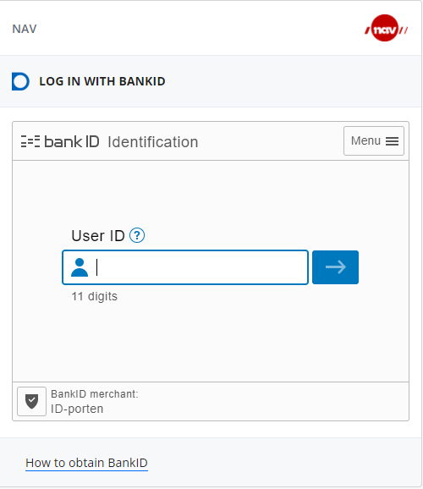
Enter your personal ID number
The persoanl ID number has 11 digits
Notes:
Manuscript:
Enter your personal ID number, 11 digits without space.
Click on the arrow or the enter button on your keyboard.

Slide 11
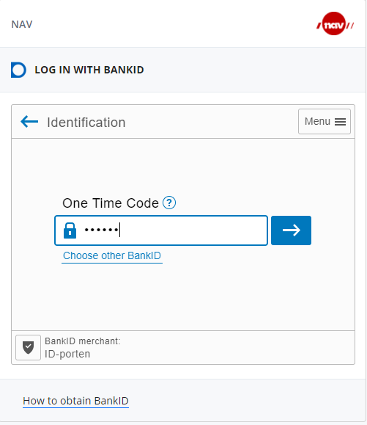
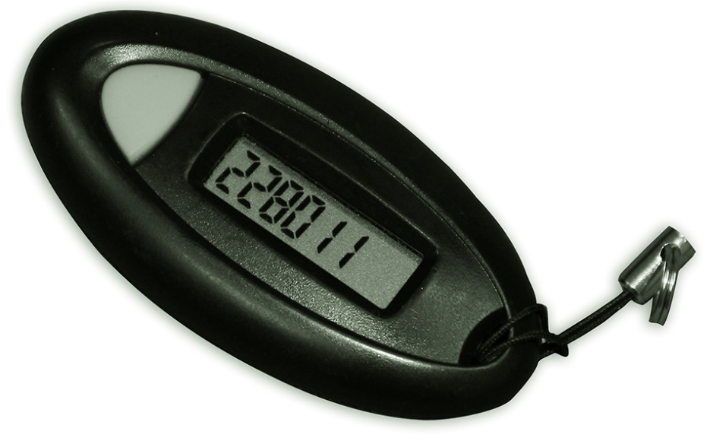
Enter the code from your code generator
Click on your code unit
Enter the code from tour code unit
Click on the arrow
Notes:
Manuscript:
Click on your code unit. A one time code will appear. Entre the one time code.
Click on the arrow or the enter button on your keyboard.
Additional information for the teacher:
Some banks offers code card or code app issued to you personally instead of a code unit.
The error message "Incorrect data entered" may appear when you enter the one-time code from the code unit during login.
This means that your BankID is not activated for public services, but can only be used to log on to your online bank.
You must activate your BankID to continue.

Slide 12
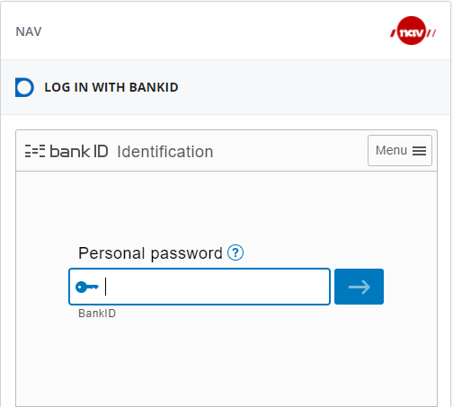
Enter your personal password
Enter the personal password
Notes:
Manuscript:
Enter your personal password (not a 4 digit code).
Click on the arrow or the enter button on your keyboard.
Additional information for the teacher:
If you enter the personal password wrong too many times, your BankID will be blocked. Please contact your bank to reopen your BankID.

Slide 13
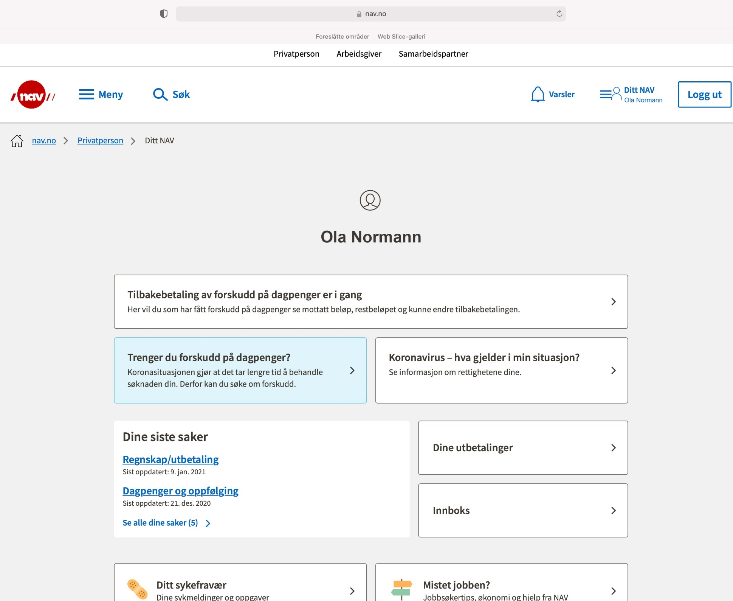
You have now logged on to NAV
Your personal services at NAV
Ola Normann
Notes:
Manuscript:
You have now logged on to NAV's services. Your name will appear on the screen.
You can find information about yourself, change information or submit forms once you have logged on.
Make sure to log out when you are done.

Slide 14
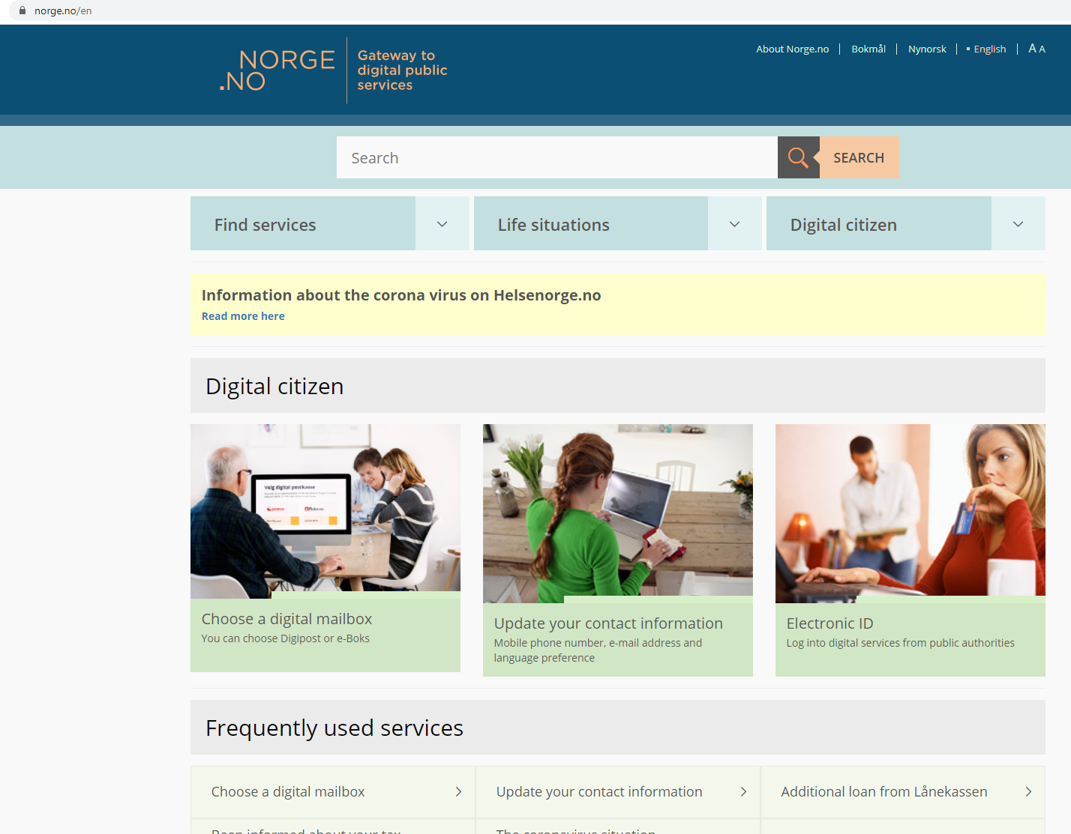
Find services on www.norge.no
Enter www.norge.no in the address bar in your browser
Notes:
Manuscript:
At Norge.no we have gathered digital services from central and local government you can log on to.
You can look for a specific service, you can find a service based on the life situation you are in, and you can search for services on Norge.no
Additional information for the teacher:
At Norge.no you can log on and change your contact information that central and local government can reach you at.
You will also find information about digital mailbox.
A separate course has been created on how to find services from www.norge.no. There are also separate courses in how to log on with your electronic ID MinID and BankID on mobile.

Slide 15
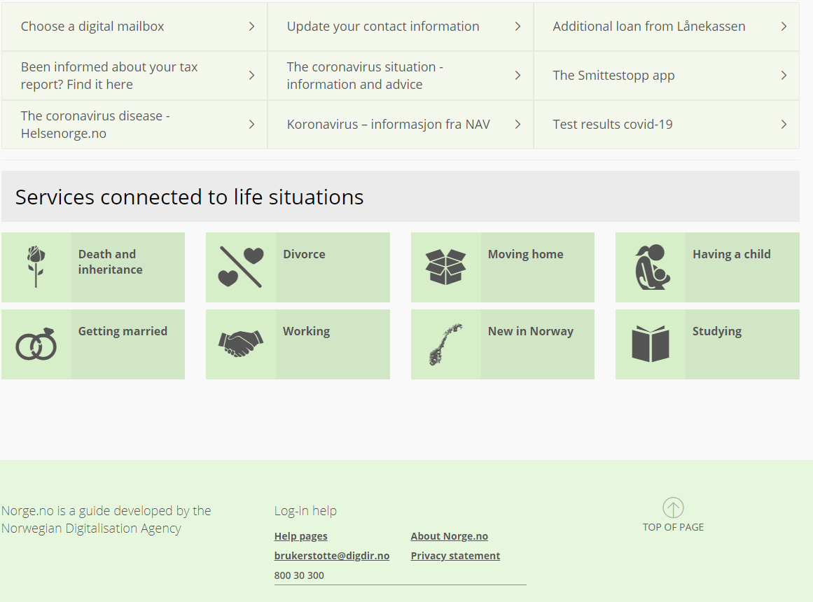
You can find help to log on at Norge.no
Help desk ID-porten
Notes:
Manuscript:
If you need help logging in, go to the bottom of the page. There is a link to our help pages, you can send us an email or a chat. You can call our help desk at tel. 800 30 300.
Additional information for the teacher:
Our website address: www.idporten.no .
On our website you can find help and information about all our electronic ID’s.

