Slide 1
Choose a digital mailbox
Notes:
Manuscript:*
This course is made for those who wants to learn how to create a digital mailbox on Norge.no. Public agencies want to send your post digitally instead of on paper.
Additional information for the teacher:**
If you want the course to be a practical course in creating a digital mailbox, the participants must have obtained a log in on the highest level of security (level 4) before the course starts. MinID is not an option to create a digital mailbox. It is possible to log in with MinID when you have a digital mailbox. But if the letter requires the highest level of security (level 4), MinID will not be an option. This includes letters to your health information, or letters where there is sensitive information about you. Then you have to log in with the highest level of security (level 4).
There are also separate courses in how to get different electronic ID`s.
*«Manuscript»: The teacher should use this information to more clearly present the information in the slides.
**«Additional information for the teacher»: This is only background information for the teacher to have some more knowledge about Norge.no, or if the participants have questions.

Slide 2
What is a digital mailbox? - a secure online service that can receive and store mail.
Digital mailbox is similiar to the mailbox you get post by paper
Digital mailbox is more secure then the mailbox you get post by papir in
Notes:
Manuscript: Digital mailbox is similar to the mailbox you get post by paper. To ensure that unauthorized people can not read your mail, it is sent encrypted to your digital mailbox. A digital mailbox is a secure digital solution for receiving and storing important post from public agencies. The mail will be stored for as long as you have your digital mailbox.
Additional information for the teacher:
You choose which digital mailbox you prefer.
You will be notified by text message or e-mail when you receive important post from an agency.

Slide 3
Why digital mailbox is recommanded
You will receive digital mail more secure
A digital mailbox is a secure digital solution for receiving and storing important post from public and private agencies.
You will receive post where you are.
You save the environment and help reduce public spending.
Notes:
Manuscript: Letters concerning decisions, health information and other sensitive information cannot be sent by normal e-mail. Normal e-mail is not secure enough.
Additional information for the teacher:
Digital mailbox is free to set up and use, and let you store letters for as long as you want.
You will not receive public advertising to your digital mailbox
To ensure that unauthorized people can not read your mail, it is sent encrypted to your digital mailbox. An encrypted transmission can be compared to putting on a padlock. Only the one who holds the key can unlock and read the content.
Read more about digital mailbox at https://www.norge.no/en/about-digital-mailbox

Slide 4
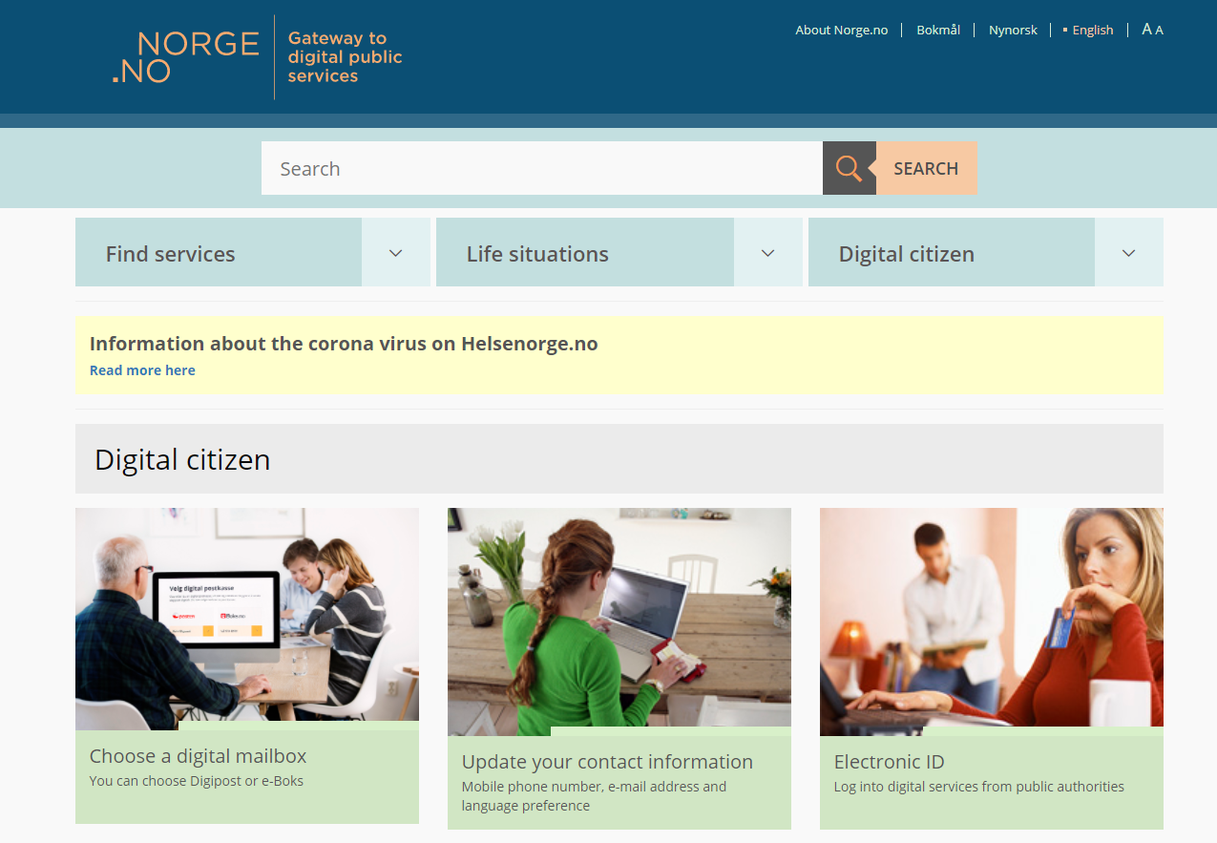
How to get a digital mailbox
Go to www.norge.no
Notes:
Manuscript:
Go to www.norge.no.

Slide 5
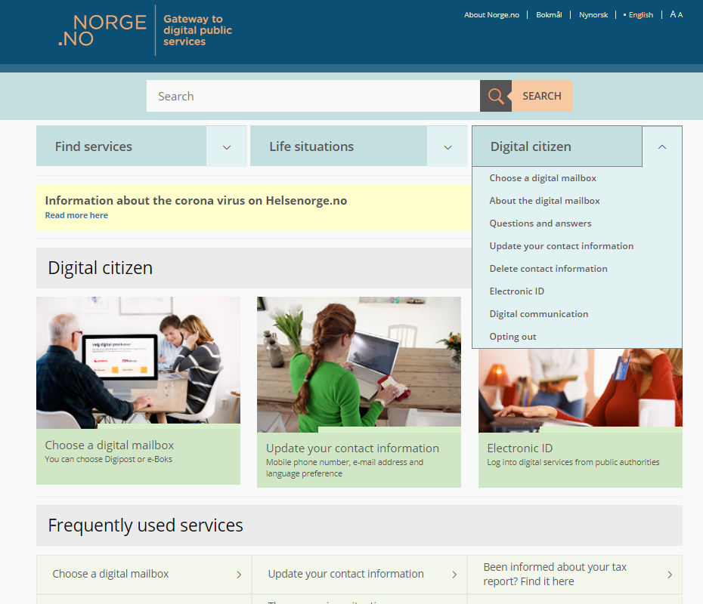
Go to digital citizen and select «Digital mailbox»
Click on one of the alternatives
Notes:
Manus:
On www.norge.no you can enter the page «Choose digital mailbox» from three places.
Click on the menu «Digital citizen». Then click «Choose a digital mailbox» from the drop-down menu.
Click the picture «Choose a digital mailbox».
Click on «Choose a digital mailbox» under «Frequently used services».
Additional information for the teacher:
The URL is: https://www.norge.no/en/choose-digital-mailbox

Slide 6
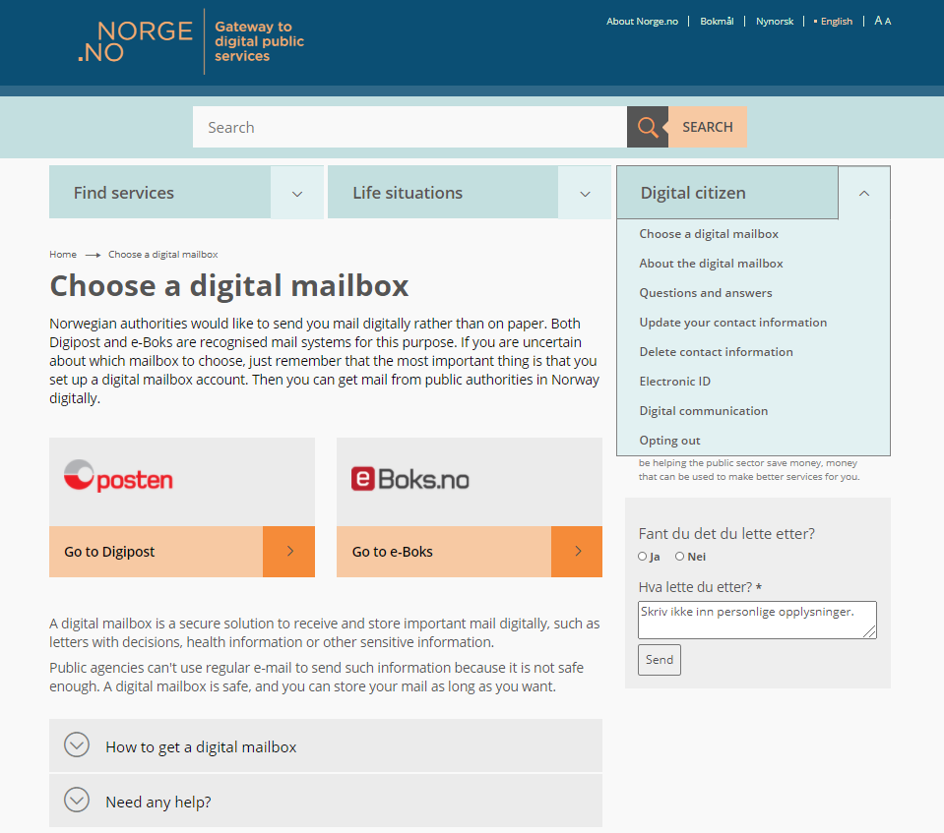
Read information about digital mailbox
Information about digital mailbox
Notes:
Additional information for the teacher:
You will find more information about digital mailbox in the drop-down menu «About the digital mailbox» and «Questions and answers» on Norge.no

Slide 7
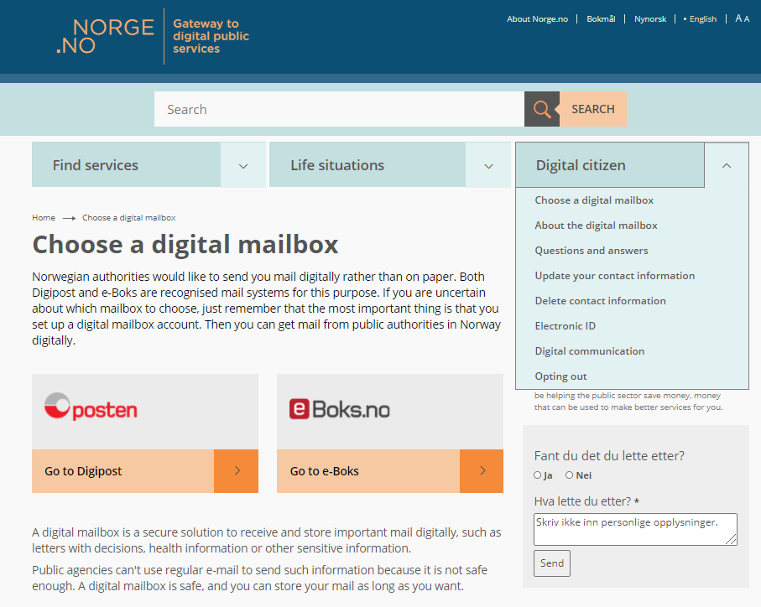
Choose a digital mailbox
Click on Digipost
Click on e-Boks
Notes:
Manuscript:
From the drop-down menu «Digital citizen» click on «Choose a digital mailbox».
If you want to register a mailbox from Digipost, click on «Go to Digipost».
If you want to register a mailbox from e-boks, click on «Go to e-boks».
Additional information for the teacher:
To create a digital mailbox you need an electronic ID at the highest level of security (level 4). MinID provides access to online public services at a substantial level of security (level 3), and can therefore not be used to create a digital mailbox.

Slide 8
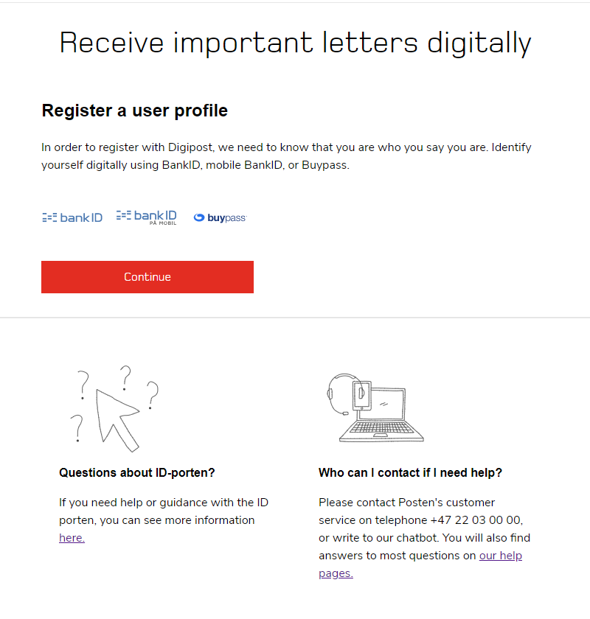
Registration at Digipost
Notes:
Manuscript:
After you have clicked «Go to Digipost» you will enter this page. Follow the instructions to create a mailbox from Digipost.
When you create a digital mailbox from Digipost or e-Boks, will the mailbox you choose automatically be chosen as a digital mailbox for public agencies.
A separate course has been created on how to create a digital mailbox from Digipost. Check out a digidel.
Additional information for the teacher:
If the user already have chosen a digital mailbox, but wishes to change to the other, the user needs to log in to the user profile in ID-porten to change it. User profile: https://brukerprofil.difi.no/minprofil

Slide 9
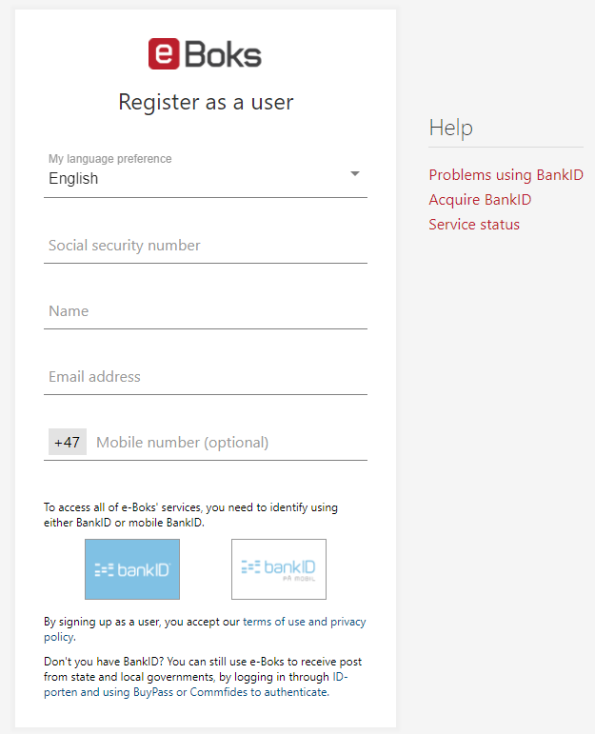
Registration at e-Boks
Notes:
Manuscript:
After you have clicked «Go to e-Boks» you will enter this page. Follow the instructions to create a mailbox from e-Boks.
When you create a digital mailbox from Digipost or e-Boks, will the mailbox you choose automatically be chosen as a digital mailbox for public agencies.
A separate course has been created on how to create a digital mailbox from e-Boks. Check out a digidel.
Additional information for the teacher:
If the user already have chosen a digital mailbox, but wishes to change to the other, the user needs to log in to the user profile in ID-porten to change it. User profile: https://brukerprofil.difi.no/minprofil

Slide 10
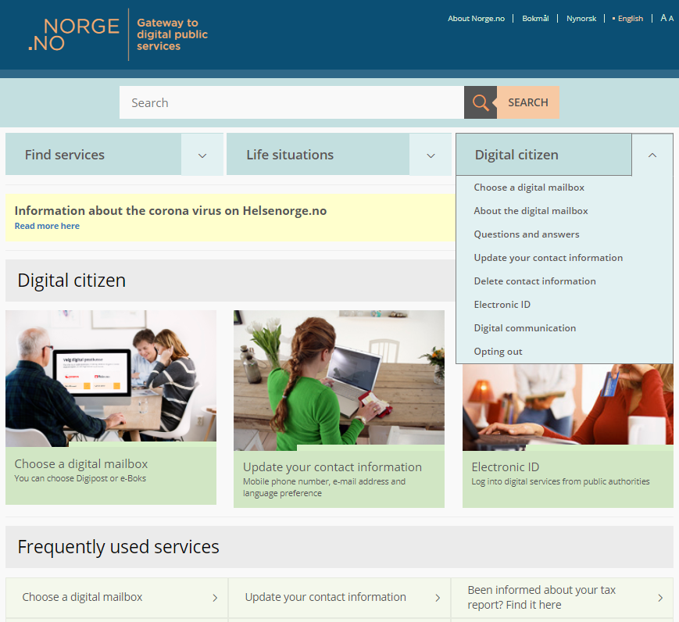
More information about digital mailbox
You can find more information and question and answers here
Notes:
Additional information for the teacher:
Under the drop-down menu «Digital citizen» you can find information about digital mailbox, question and answers, electronic ID etc.

Slide 11
Receive mail from public authorities digitally
Notes:
Additional information for the teacher:
The video «Receive mail from public authorities digitally» tells you why it is recommanded to create a digital mailbox.
Click on the headline «Receive mail from public authorities digitally» to see the movie. You can see the movie in fullscreen by clicking the «fullscreen icon» down in the right corner.
Link to the movie: YouTube: https://www.youtube.com/watch?v=TolO-RVkg80

